Slide 1
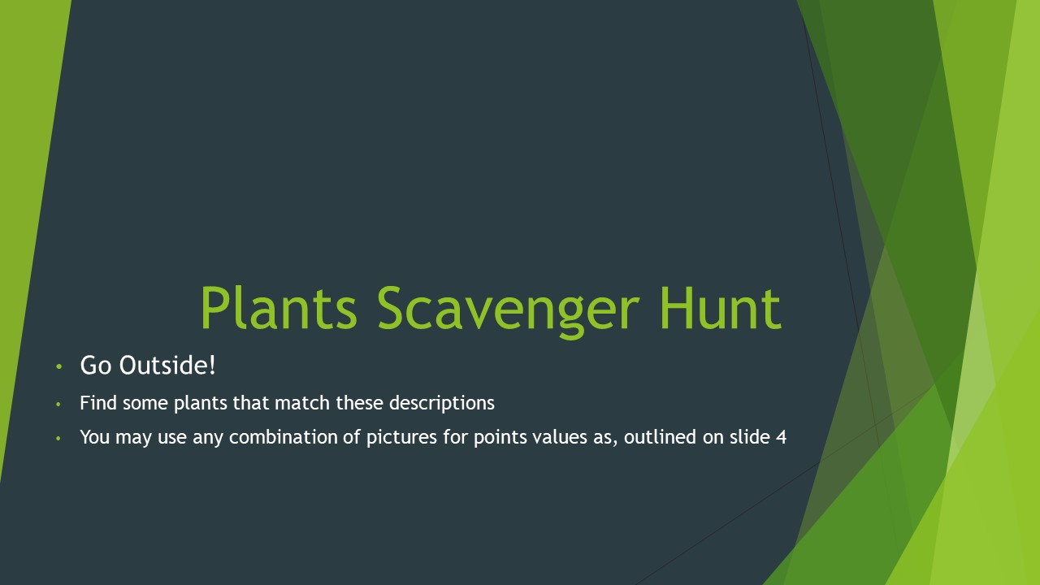

Slide 2
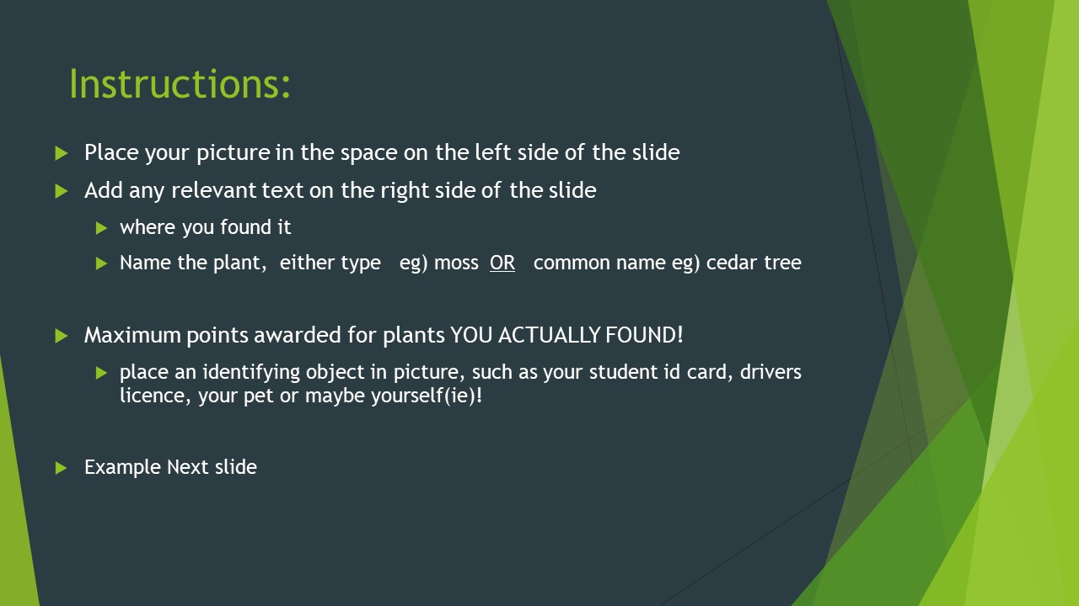

Slide 3
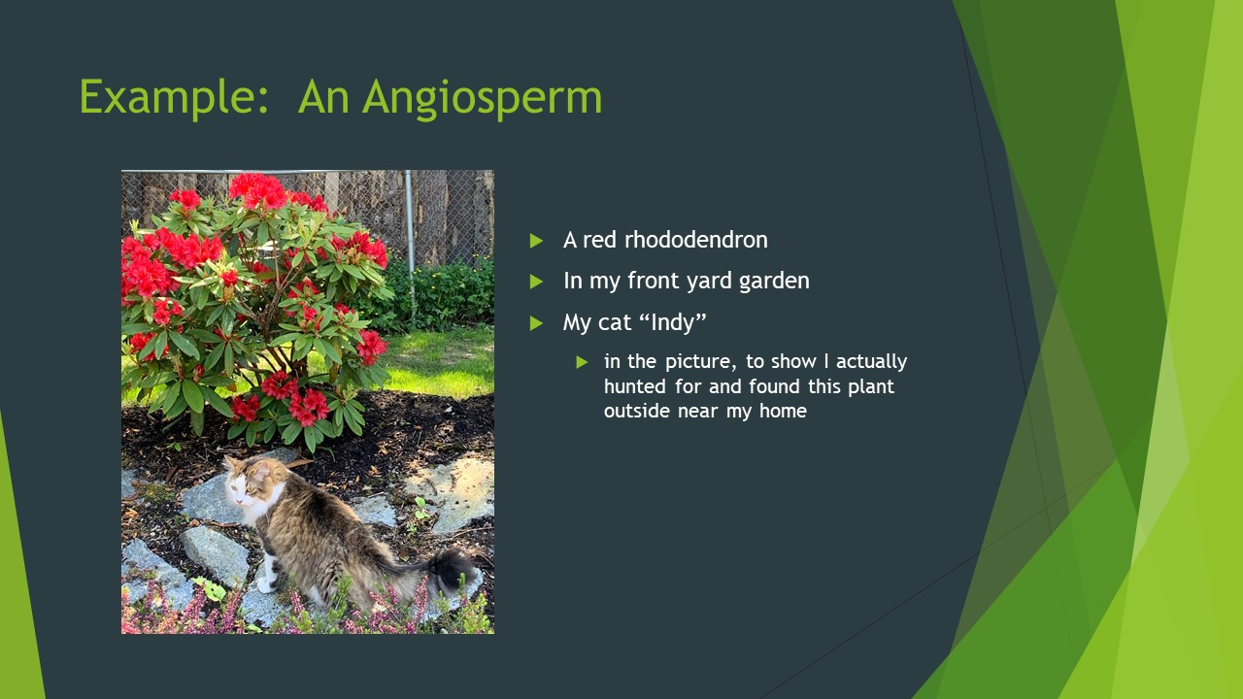

Slide 4
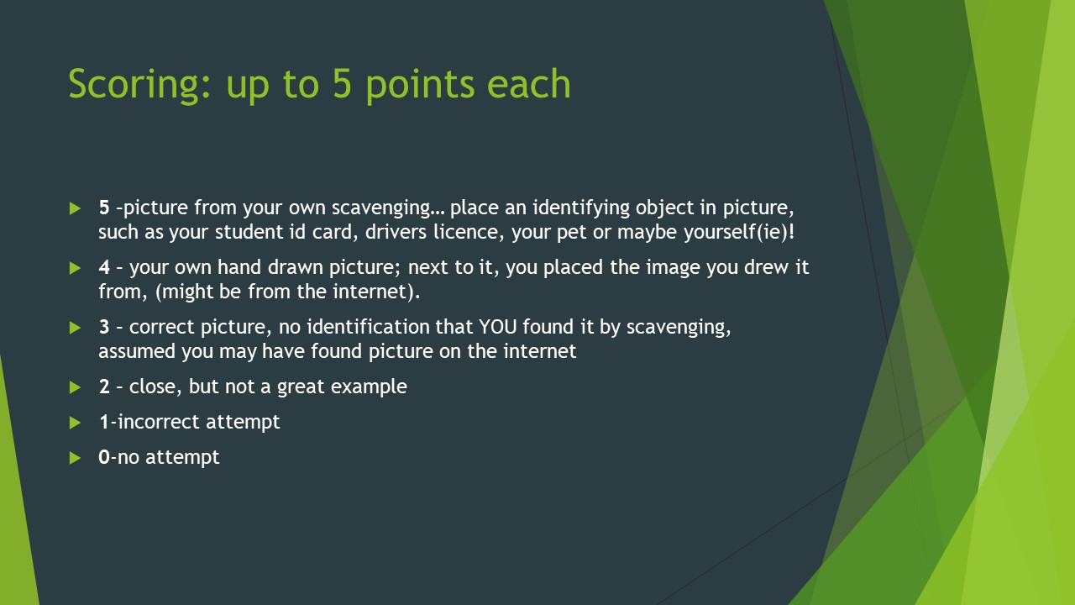

Slide 5

Picture Here
Type Here

Slide 6

Picture Here
Type Here

Slide 7
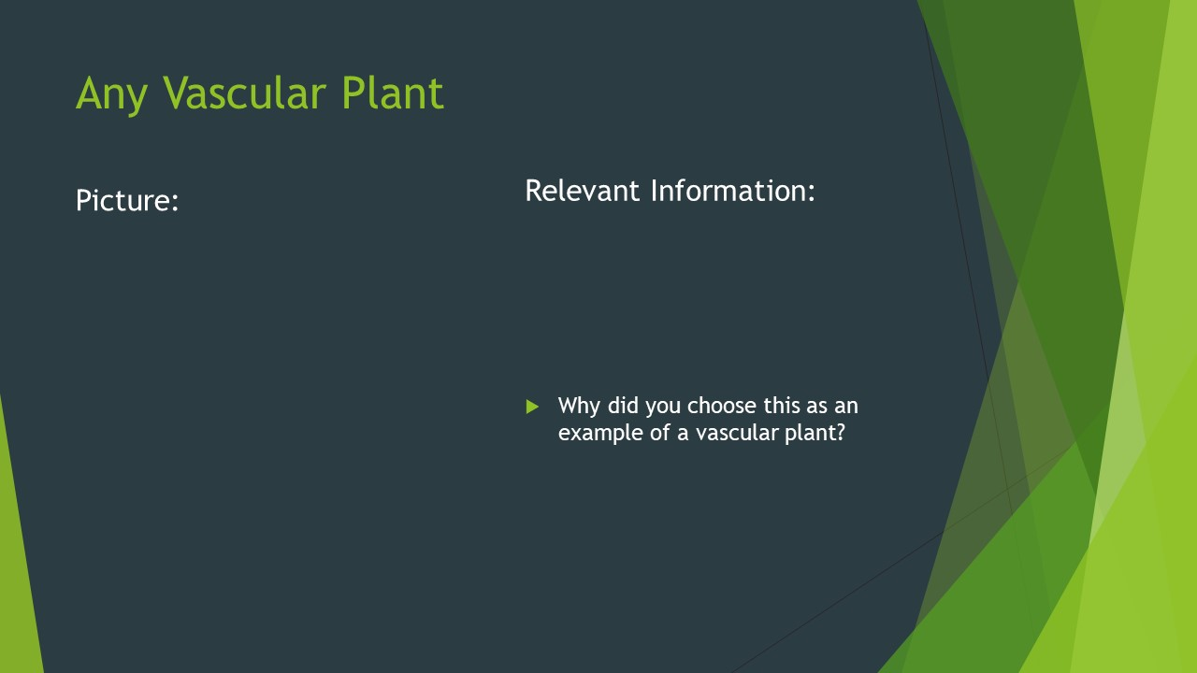
Type Here
Picture Here
Type Here

Slide 8

Picture Here
Type Here

Slide 9

Picture Here
Type Here

Slide 10

Picture Here
Type Here

Slide 11

Picture Here
Type Here

Slide 12
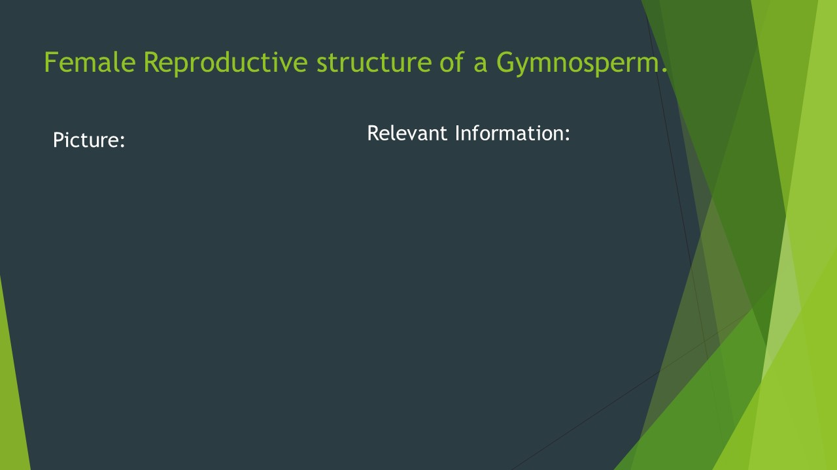
Picture Here
Type Here

Slide 13
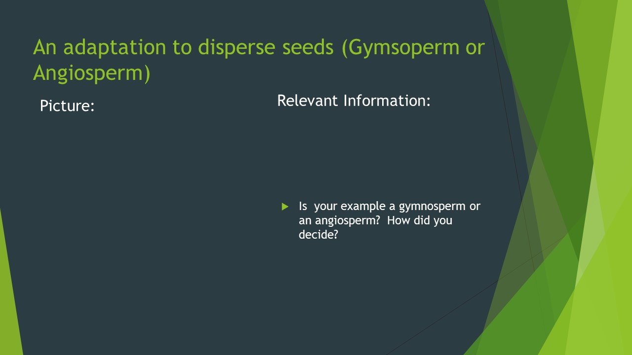
Picture Here
Type Here
Type Here

Slide 14

Picture Here
Type Here

Slide 15

Picture Here
Type Here

Slide 16

Picture Here
Type Here

Slide 17

Picture Here
Type Here

Slide 18
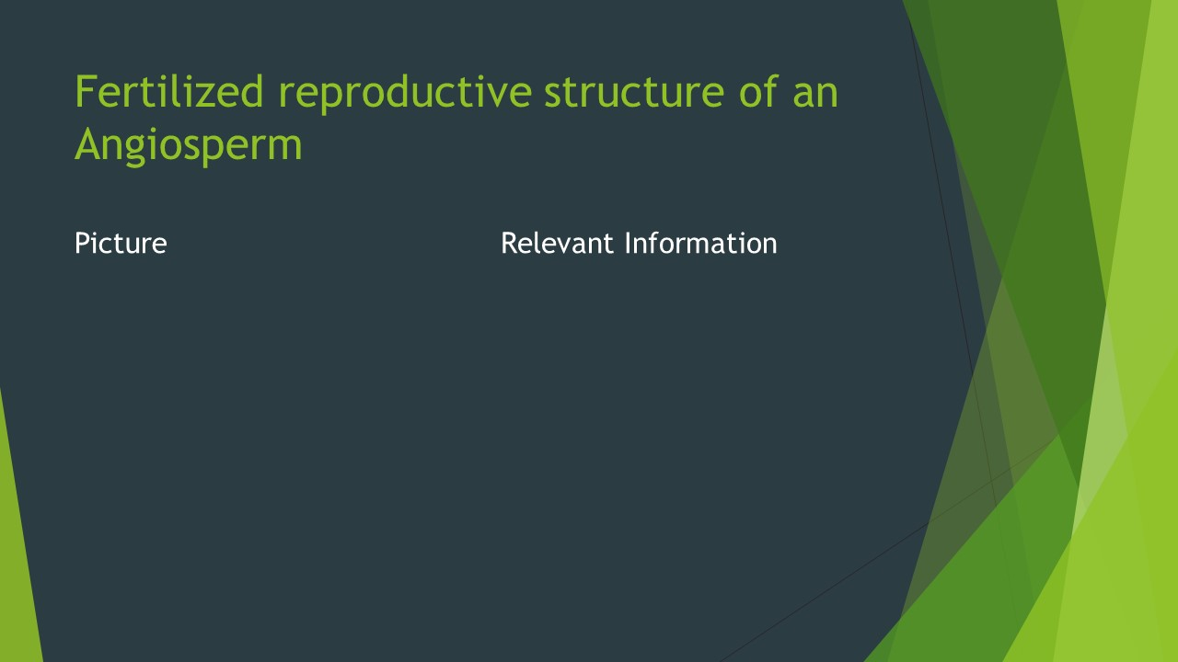
Picture Here
Type Here

Slide 19

Picture Here
Type Here

Slide 20

Picture Here
Type Here

Slide 21
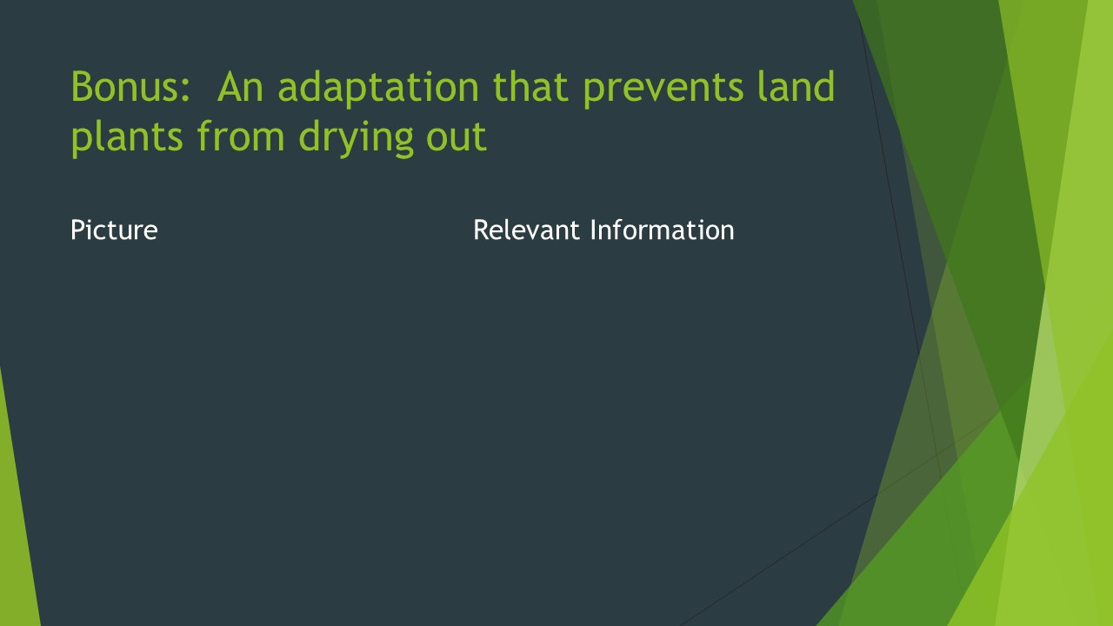
Picture Here
Type Here

Slide 22
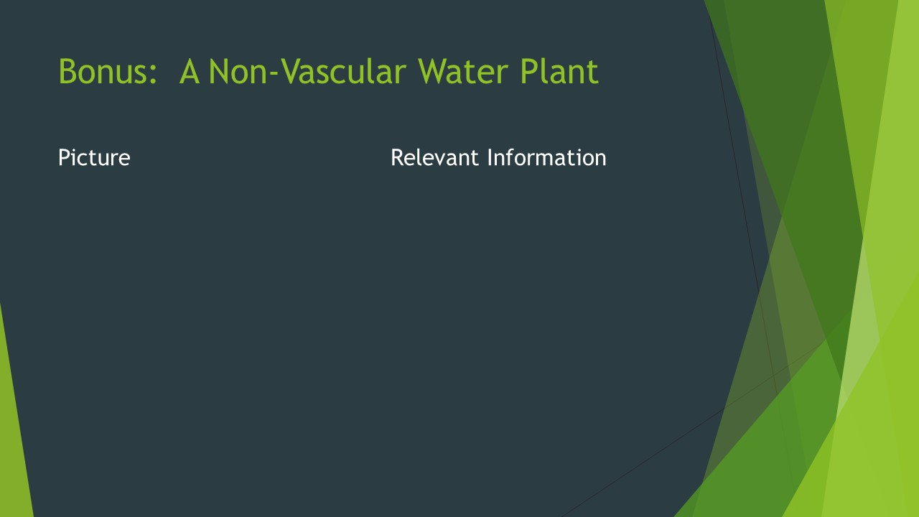
Picture Here
Type Here

